Slide 1
Computerized Accounting with QuickBooks 2015

Slide 2
Payroll Setup
Custom Setup

Slide 3
Objectives
In this chapter, you will:
Review payroll terminology
Activate the payroll preference
Customize payroll system default accounts
Customize and update the Chart of Accounts List for payroll
Set up payroll to accept manual entries
Customize the Payroll Item List for payroll items created by QuickBooks
Update the Payroll Item List
Display and print the Payroll Item Listing report

Slide 4
Introduction
QuickBooks allows you to process payroll and track payroll information for your company’s employees
Payroll involves:
computing each employee’s gross earnings
determining each employee’s withholding and deductions
Withholdings refer to the payroll taxes the employer is required to take out of the employee’s paycheck and submit to the appropriate government agency.
Deductions refer to the amount taken out of the employee’s paycheck for various fringe benefits such as insurance, pension, and so on.
calculating each employee’s net pay
preparing employee paychecks
properly recording payroll-related transactions (journal entries)
submitting payroll withholdings to the appropriate tax agency or other entity
preparing payroll compliance reports

Slide 5
Introduction Cont.
In order to process payroll in QuickBooks, the payroll must first be set up.
Payroll setup involves
enabling the payroll feature
customizing and adding payroll accounts to the Chart of Accounts List
choosing a QuickBooks payroll service or activating the manual entries feature
customizing pre-established payroll items
establishing payroll items such as compensation and payroll taxes or payroll deductions
These payroll items comprise the Payroll Item List.

Slide 6
QuickBooks v. Manual Accounting
In a manual accounting system the process of preparing a payroll is laborious and time-consuming.
For each employee, the company has to
tally the hours worked in a pay period
compute the gross pay for the pay period
determine all the withholdings and deductions from the employee’s pay
After completing these computations, the company has to
prepare pay checks
prepare pay stubs showing all the earnings, withholdings, and deductions for the pay period
prepare all the year-to-date earnings, withholdings, and deductions

Slide 7
QuickBooks v. Manual Accounting Cont.
Payroll was one of the first accounting tasks to be available on computers.
Payroll preparation firms were formed for this sole purpose.
A company simply prepares a list of each employee’s name and the hours that person worked during a pay period.
This information is submitted to the payroll processing firm and usually overnight the payroll is prepared:
company receives its properly completed paychecks and a summary report the next morning
paychecks are distributed to the employees
summary report is used to record the appropriate journal entries for the payroll
payroll processing firms also accumulate the necessary information for preparing government compliance reports

Slide 8
QuickBooks v. Manual Accounting Cont.
Without the use of computers
payroll withholdings are calculated manually using preprinted withholding tables
gross pay, withholdings, and deductions for all employees has to be totaled in order to record the payroll in a payroll journal
gross pay, withholdings, and deductions are then posted to the general ledger accounts
year-to-date earnings and withholdings need to be accumulated and used in preparing government-required quarterly and year-end reports
in dealing with such a quantity and variety of computations, it is easy to make a mistake

Slide 9
QuickBooks v. Manual Accounting Cont.
QuickBooks includes a payroll feature that, once activated, allows for
processing a payroll with employees’ earnings, withholdings, deductions, and net pay
quick and easy calculations
simultaneous recording of the payroll transactions in the journal
paychecks to be immediately printed when the printer is set up to do so
Simultaneously, reports are prepared that summarize all quarterly and annual information needed for required filings, and for required payments of employee withholdings to the appropriate agencies

Slide 10
QuickBooks v. Manual Accounting Cont.
Part of what makes payroll processing in QuickBooks easier than that of a manual system is the use of Lists/Centers (which function as a data base)
Typical gross earnings, withholdings, and deductions, are detailed in the Payroll Item List
In addition, exact payroll taxes are maintained within the payroll feature and QuickBooks payroll services

Slide 11
Payroll Definitions and Terms
The following are the same whether payroll is processed manually or with a software package
laws
procedures
filing requirements
definitions
terminology

Slide 12
Payroll Definitions and Terms Cont.
Employee Payroll Information
In order to properly determine an employee’s gross pay, tax withholdings, deductions, and net pay, and to meet federal and state record-keeping requirements, the employer needs specific information about the employee.
Name
Address
Social Security number
Marital status
Gross pay amount or hourly rate
Tax withholding allowances
Voluntary deductions (pensions, 401K, insurance, and so on)
The employer uses this information along with the applicable tax rates to compute the employee’s paycheck and track the employee’s pay information.

Slide 13
Payroll Definitions and Terms Cont.
Gross Pay
Gross pay is the total earnings for the employee for a specific pay period before any withholdings and deductions.
Compensation can be in the form of
Salary: if the employee is paid based upon an annual salary, the annual figure is divided over the number of pay periods in the year
Hourly wages: gross pay for hourly workers is determined based on the number of hours worked during the pay period multiplied by the employee’s hourly pay rate
Tips, commissions, bonus, and overtime earned during a pay period
Gross pay will be subject to payroll taxes, for both the employer and employee.

Slide 14
Quick Check
Which definition is correct?
The person that works for the company is called the employer.
The company that hires the workers is referred to as the employee.
Net pay is the total earnings for an employee minus all employee withholdings and deductions.
Gross pay is the total earnings for an employee for a specific pay period after withholdings and deductions.

Slide 15
Payroll Definitions and Terms Cont.
FICA Tax (Social Security) and Medicare Tax
Federal Insurance Contribution Act (FICA) tax, also known as Social Security, is a tax imposed on both the employer and employee.
rate of 6.2% of the first $118,500 (year 2015) of wages for each employee
Medicare tax is also imposed on both the employer and the employee
rate of 1.45% for each
There is no wage maximum for the Medicare tax.
Beginning 2013, there is an Additional Medicare Tax of 0.9% which has a different maximum for different taxpayers ($250,000/$200,000)
Employers periodically remit both the employer and employee portion of the tax to the federal government.

Slide 16
Payroll Definitions and Terms Cont.
Federal Income Tax (FIT)
Employers are required to withhold from each employee’s pay the appropriate amount of federal income tax (FIT).
The Internal Revenue Service publishes tables and instructions in order to assist employers in determining the proper withholding amount for each employee.
The withholding amount is determined based upon the employee’s gross pay, marital status, and exemption allowances claimed.
The employer periodically forwards the tax withheld to the federal government along with the Social Security and Medicare taxes.

Slide 17
Payroll Definitions and Terms Cont.
State Income Tax (SIT)
Many states impose an income tax and require employers to withhold the tax from the employees’ pay, in a manner similar to that used for FIT.
Employer will remit this tax periodically to the appropriate state taxing authority.
Some local governments (city, county) may also impose income taxes.
Federal Unemployment Insurance Tax (FUTA)
Federal Unemployment Insurance (FUTA) tax is imposed on only the employer.
Tax is used to fund unemployment insurance programs administered by the federal government.
Effective rate of the tax 0.6% of the first $7,000 of each employee’s wages.

Slide 18
Payroll Definitions and Terms Cont.
State Unemployment Insurance (SUI)
In addition to paying the FUTA tax, employers are required by all states to contribute to a state unemployment insurance (SUI) fund.
Rates and regulations vary from state to state.
However, most states impose the tax only on the employer.
Rates can vary up to 11% based upon the employer’s location and unemployment experience, and the taxable amount varies from state to state.
State Disability Insurance (SDI)
Most states require employers to purchase an insurance policy that compensates employees if they are unable to work for an extended period due to illness or injury.
Some states allow employers to withhold a small amount from each employee’s pay to defray the employer’s insurance premium cost.

Slide 19
Payroll Definitions and Terms Cont.
Company Deductions
Many employers will sponsor various fringe benefit programs and deduct amounts from employee’s pay to fund or offset the costs of the benefits programs such as
401K plans
medical and dental insurance
pension and profit-sharing plans
long-term disability
life insurance, and so on
May be partially funded by a deduction made by the company from an employee’s paycheck

Slide 20
Payroll Definitions and Terms
Net Pay
Net pay is the amount of the employee’s gross pay less all employee withholdings and deductions.
Net pay is only a fraction of the gross pay earned.
United States Treasury
The United States Treasury is the tax-collecting agency of the federal government.
The United States Treasury is responsible for collecting
FICA tax
Medicare tax
FIT
FUTA tax

Slide 21
Payroll Setup—Activate the Payroll Feature
To set up payroll in QuickBooks, you must first activate (enable) the payroll feature.
In the company file for this chapter, the payroll feature needs to be activated in the Preferences window on the Edit menu.
Click Edit and then click Preferences.
Along the left frame of the Preferences window, click the Payroll & Employees icon.
Click the Company Preferences tab.
Click the Full payroll option.
Accept the defaults, and click OK.
Once the Payroll feature is activated, QuickBooks automatically creates two default general ledger accounts:
Payroll Liabilities
Payroll Expenses

Slide 22
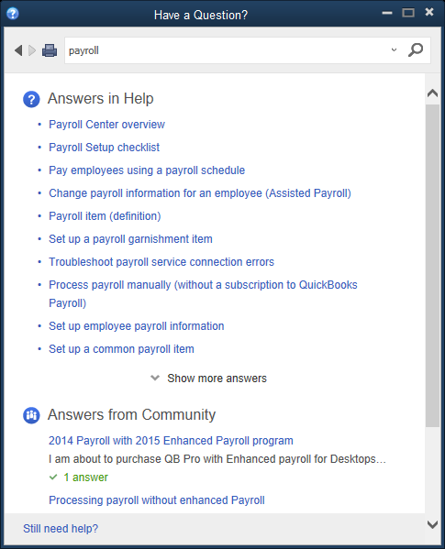
Payroll Setup—Activate the Payroll Feature Cont.
To set up payroll for manual processing using the Help menu:
Click Help and then click QuickBooks Help. The Have a Question? window appears.
In the Have a Question? window, in the Search box, key payroll and press Enter or click the search icon. Some payroll topics are displayed.
In the Answers in Help section, click Show more answers. Additional payroll topics are displayed.

Slide 23
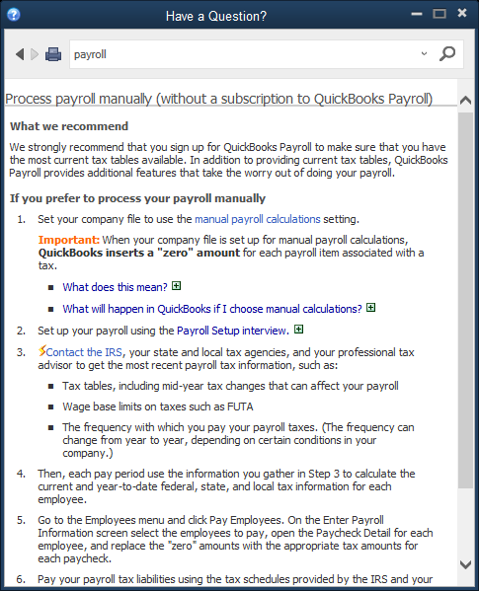
Payroll Setup—Activate the Payroll Feature Cont.
Scroll down the list of payroll topics and click the Process payroll manually (without a subscription to QuickBooks Payroll) link. The Process payroll manually (without a subscription to QuickBooks Payroll) information appears in the Have a Question? window.

Slide 24
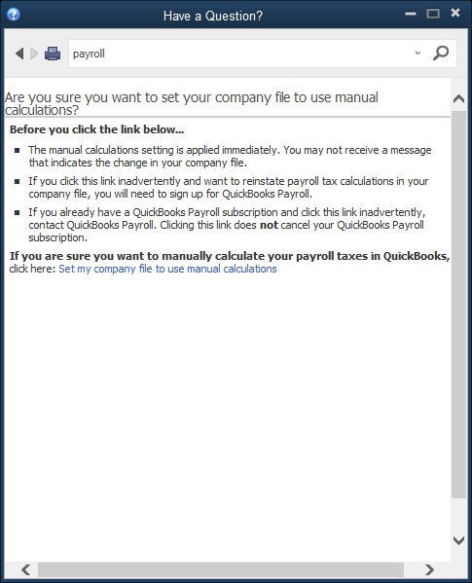
Payroll Setup—Activate the Payroll Feature Cont.
In the Have a Question? window, under the If you prefer to process your payroll manually section, click the manual payroll calculations link.
Click the Set my company file to use manual calculations link.
Close the Have a Question? window, and then click OK at the QuickBooks Information message.

Slide 25
Updating the Chart of Accounts List for Payroll
When the payroll feature is activated, QuickBooks establishes
one default general ledger liability posting account for all payroll-related liabilities
one default general ledger expense posting account for all payroll-related expenses
Open and review the Chart of Accounts List
accounts created by QuickBooks are 24000 Payroll Liabilities and 66000 Payroll Expenses
When both of these accounts are created, the account type is dimmed to indicate that QuickBooks created the account and it is a system default account.
Recall that you must allow QuickBooks to create its own accounts in some situations, but then you can edit the account name and account number.

Slide 26
Updating the Chart of Accounts List for Payroll Cont.
To review the Payroll Item List created by QuickBooks:
Click Lists and then click Payroll Item List .
The Payroll Item List appears.

Slide 27
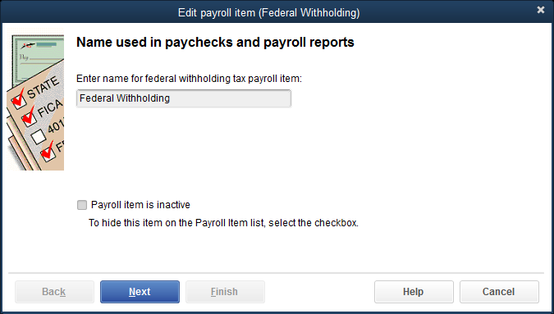
Updating the Chart of Accounts List for Payroll Cont.
To view a specific payroll item, such as Federal Withholding:
Double-click Federal Withholding. The Edit payroll item (Federal Withholding) window appears.

Slide 28
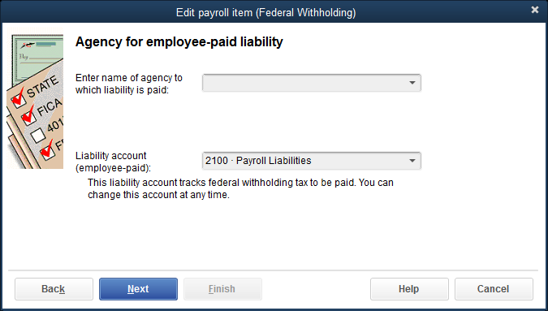
Updating the Chart of Accounts List for Payroll Cont.
Click Next, and the Agency for employee-paid liability page appears.
Click Next to move to the next page, Taxable compensation. This page indicates all items subject to federal income tax withholdings. Taxable Compensation payroll items are added to the Payroll Item List, this page is automatically updated.
Click Finish. You are returned to the Payroll Item List window.
Close the Payroll Item List.

Slide 29
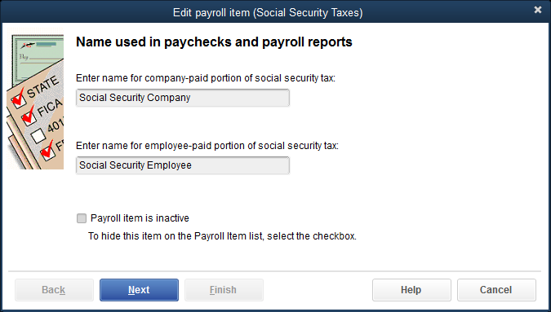
Customize the Payroll System Default Accounts
To customize the Social Security Company payroll item:
Click Lists and then click Payroll Item List
Choose the Social Security Company payroll item by double-clicking. The payroll item is opened in Edit mode

Slide 30
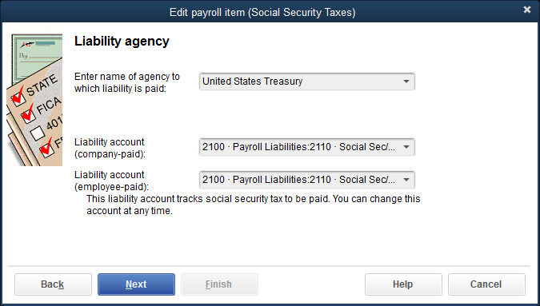
Customize the Payroll System Default Accounts Cont.
Accept the default names and then click Next. The Liability agency page appears
At the Enter name of agency to which liability is paid field, click United States Treasury from the drop-down list
At both the Liability account (company-paid) field and the Liability account (employee-paid) field, click 2110 Social Sec/Medicare Tax Payable. Both the parent account 2100 Payroll Liabilities and the subaccount 2110 Social Sec/Medicare Payable are displayed.

Slide 31
Customize the Payroll System Default Accounts Cont.
If the information is correct, click Next. The Expense account page appears. (Only the employer’s portion of Social Security and Medicare is considered an expense for the company.)
At the Enter the account for tracking this expense field, click 6610 Social Sec/Medicare Tax Expense. Both the parent account 6560 Payroll Expenses and the subaccount 6610 Social Sec/Medicare Expense are displayed.
If the information is correct, click Next.
Click Next to accept. The Taxable compensation page appears.
Click Finish. You will be returned to the Payroll Item List with all changes saved.

Slide 32
Customize the Payroll System Default Accounts Cont.
To customize the Federal Unemployment payroll item:
Click Lists and then click Payroll Item List.
Choose the Federal Unemployment payroll item by double-clicking.
Accept the default name Federal Unemployment by clicking Next.
In the Enter name of agency to which the liability is paid field, click United States Treasury from the drop-down list.
In the Liability account field, click 2125 FUTA Payable. Both the parent account 2100 Payroll Liabilities and the subaccount 2125 FUTA Payable are displayed.
In the Expense account field, click 6625 FUTA Expense. Both the parent account 6560 Payroll Expenses and the subaccount 6625 FUTA Expense are displayed. Notice on this page that you are listing one liability account and one expense account.

Slide 33
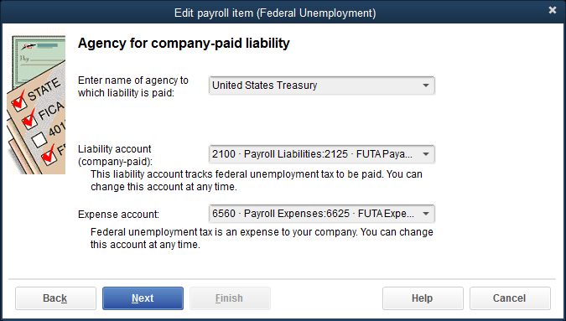
Customize the Payroll System Default Accounts Cont.
If the information is correct, click Next.
At the Federal unemployment tax rate page, accept the default rate by clicking Next.
At the Taxable Compensation page, click Finish.
Close the Payroll Item List.

Slide 34
Quick Check
Which of the following payroll taxes are imposed on the employer?
FIT, FUTA, and SUI
Social Security Tax, Medicare Tax, FIT, and SIT
Medicare Tax, FUTA, and FIT
Social Security Tax, Medicare Tax, FUTA, and SUI

Slide 35
QuickBooks Payroll Services v. Calculating Payroll Manually
Like most computerized accounting packages, QuickBooks offers several desktop payroll services.
QuickBooks Basic Payroll
QuickBooks Enhanced Payroll
QuickBooks Full Service Payroll
QuickBooks Online Payroll
A company would choose the service that best fits their company’s needs.
If a company chooses to use one of the QuickBooks payroll services, they must subscribe to the service, which requires a monthly fee.

Slide 36
Updating the Payroll Item List
In QuickBooks there are two methods for adding a payroll item
EZ Setup
The EZ Setup method guides you in setting up payroll items using the QuickBooks Payroll Setup window.
Custom Setup
The Custom Setup method allows you to directly enter information in the Payroll Item List.
Custom Setup is used in this chapter.

Slide 37
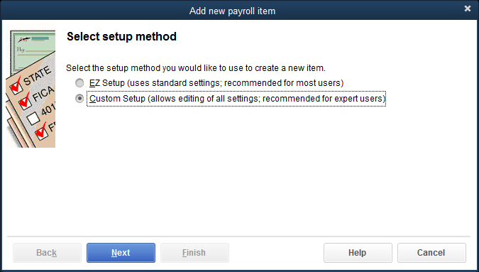
Updating the Payroll Item List Cont.
To add Salary to the Payroll Item List:
Click Lists and then click Payroll Item List.
At the Payroll Item List window, click the Payroll Item menu button.
At the Payroll Item menu, click New. The Add new payroll item window with the Select setup method page appears.
At the Select setup method page, click the Custom Setup option.

Slide 38
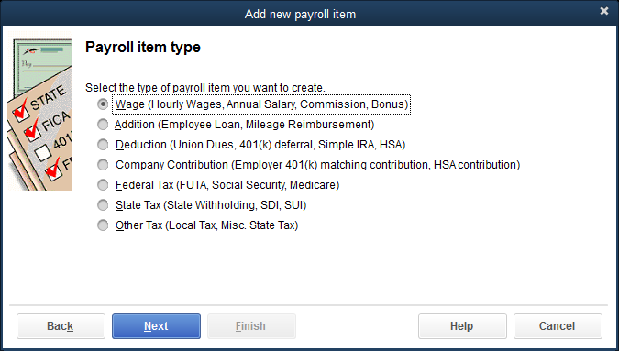
Updating the Payroll Item List Cont.
Click Next.
At the Payroll item type page, click Wage (Hourly Wages, Annual Salary, Commission, Bonus).
Click Next.

Slide 39
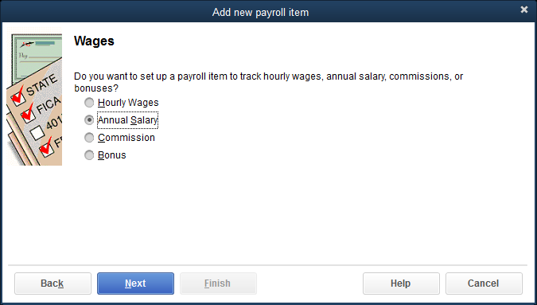
Updating the Payroll Item List Cont.
Choose the Annual Salary subtype.
Click Next.

Slide 40
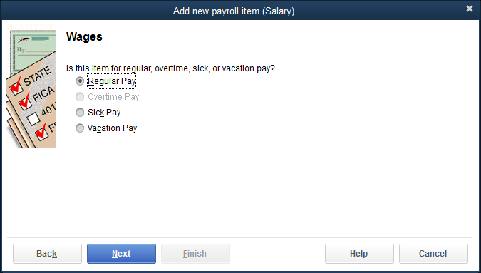
Updating the Payroll Item List Cont.
Choose Regular Pay.
Click Next.
At the Enter name for salary item field, key Salary and then click Next.

Slide 41
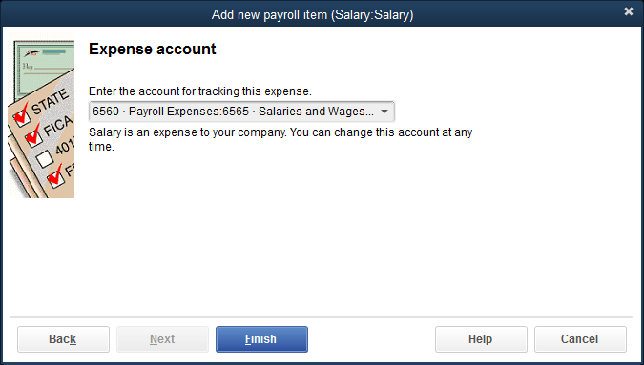
Updating the Payroll Item List Cont.
At the Enter the account for tracking this expense field, click 6565 Salaries and Wages Expense from the drop-down list.
If the information is correct, click Finish.
Close the Payroll Item List.

Slide 42
Updating the Payroll Item List Cont.
To add Minnesota state income tax to the Payroll Item List:
Click Lists and then click Payroll Item List.
At the Payroll Item List window, click the Payroll Item menu button.
At the Payroll Item menu, click New. The Add a new payroll item window with the Select setup method page appears.
At the Select a setup method page, click the Custom Setup option and then click Next. The Payroll item type page appears.
At the Payroll item type page, click the State Tax (State Withholding, SDI, SUI) type and then click Next. The State tax page appears.
At the Enter the state drop-down list, click MN. After you select a state, the subtypes that apply to the chosen state become active.
At the Select the type of tax you want to create field, click the State Withholding subtype.

Slide 43
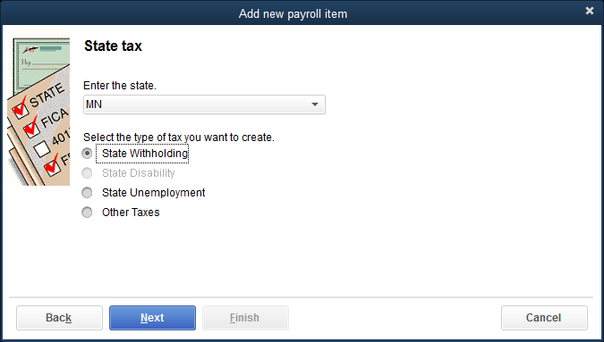
Updating the Payroll Item List Cont.
If the information is correct, click Next.
Accept the default name assigned and click Next.

Slide 44
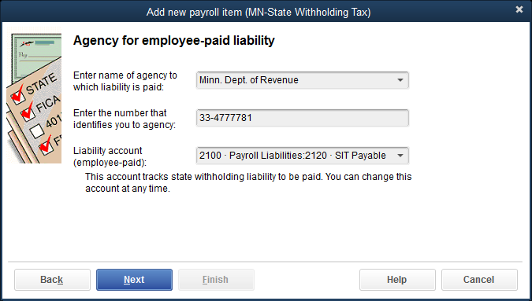
Updating the Payroll Item List Cont.
At the Enter name of agency to which liability is paid field, click Minn. Dept. of Revenue from the drop-down list.
At the Enter the number that identifies you to agency field, key 33-4777781.
At the Liability account (employee-paid) field, click 2120 SIT Payable.

Slide 45
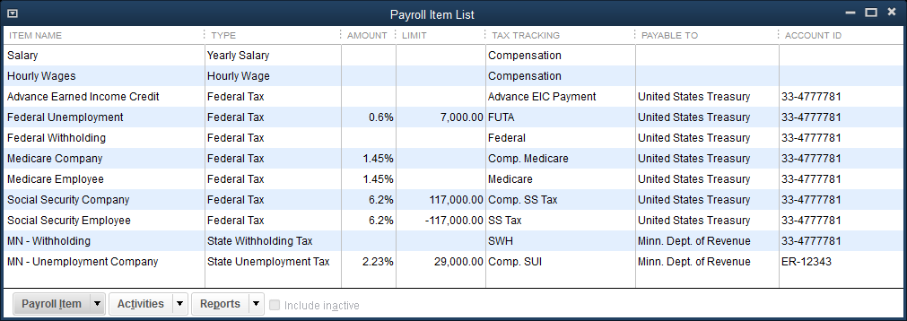
Updating the Payroll Item List Cont.
If the information is correct, click Next. The Taxable compensation page appears; it shows the types of income subject to the tax.
Click Finish. At the Schedule Payments message, click OK. You are returned to the Payroll Item List window with the new tax included.
Close the Payroll Item List.

Slide 46
Payroll Reports
Reports, the fourth level of operation in QuickBooks, allows you to display and print a number of payroll reports for internal payroll management and government and payroll tax compliance
To view the Payroll Item Listing report:
Click Reports and then click Employees & Payroll.
At the Employees & Payroll submenu, click Payroll Item Listing. The Payroll Item Listing report is displayed.

Slide 47
Terms
deductions Deductions generally refer to amounts taken out of the employee's paycheck for various fringe benefits such as insurance, pension, and so on.
employee The person hired by the company who will receive salary or wages on a regular basis.
employer The company that hires workers.
gross pay Total earnings for an employee for a specific pay period before withholdings and deductions.
net pay Total gross earnings for an employee minus all employee withholdings and deductions.

Slide 48
Terms Cont.
payroll Involves the computing of employees' gross earnings, withholdings and deductions, and net pay; the preparation of paychecks; the proper recording of payroll-related transactions; submission of payroll withholdings to the appropriate agency; and preparation of payroll compliance reports.
withholdings Withholdings generally refer to the payroll taxes the employer is required to take out of the employee's paycheck and submit to the appropriate government agency.

